Slide 1




Slide 2
Agenda
Introduction
Problem Statement
Data Preprocessing and Cleaning
Methodology
Technical Implementation
Results

Slide 3
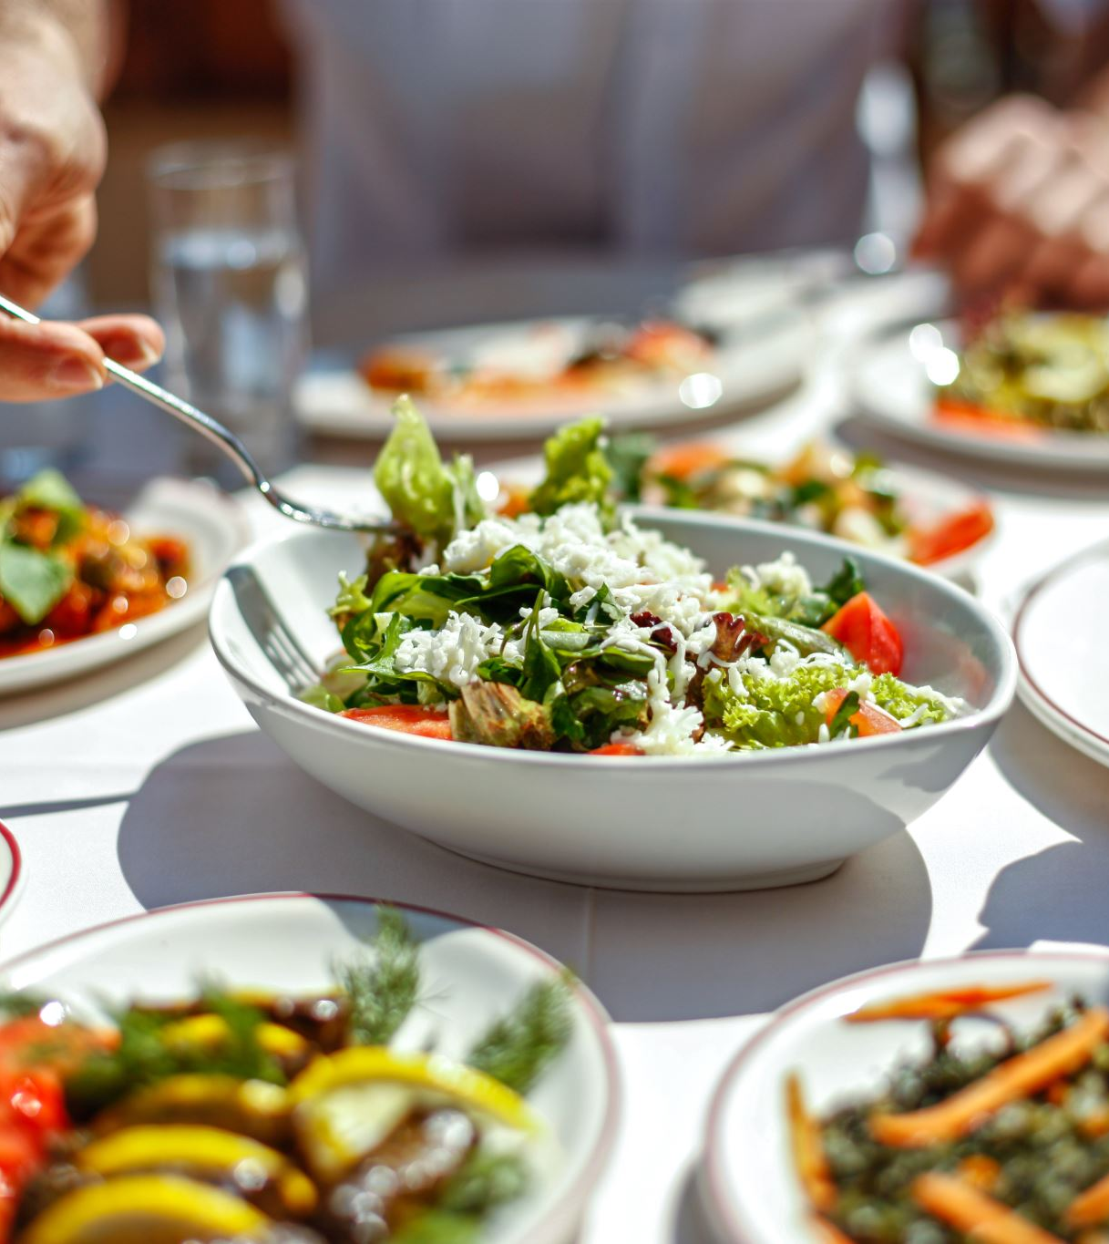
introduction
Bengaluru being one such city has more than 12,000 restaurants with restaurants serving dishes from all over the world

Slide 4

Problem Statement
We can’t rate the new restaurants so if we know some things, we can rate them
We want to know the rating of new restaurant based on its votes and the cost or approximate cost If 2 people will buy a meal

Slide 5

Data Preprocessing and Cleaning
Actually data was for EDA but we make some preprocessing to use it in our purpose like knowing the distribution of features and its correlation to choose right type of naïve bayes
We preprocess the data and clean it by:
Removing “nan” and “-” signs from features
Drop non usful columns
Convert some columns from string to numerical form
Convert the target to if the rate > 3.9 get 1 else 0

Slide 6
Methodology
par plot to showthe most repeated restaurant in the data
Also used correlation table to see the correlation between features
lastly show the percentage of restaurants that provide book table and online order with its rate

Slide 7
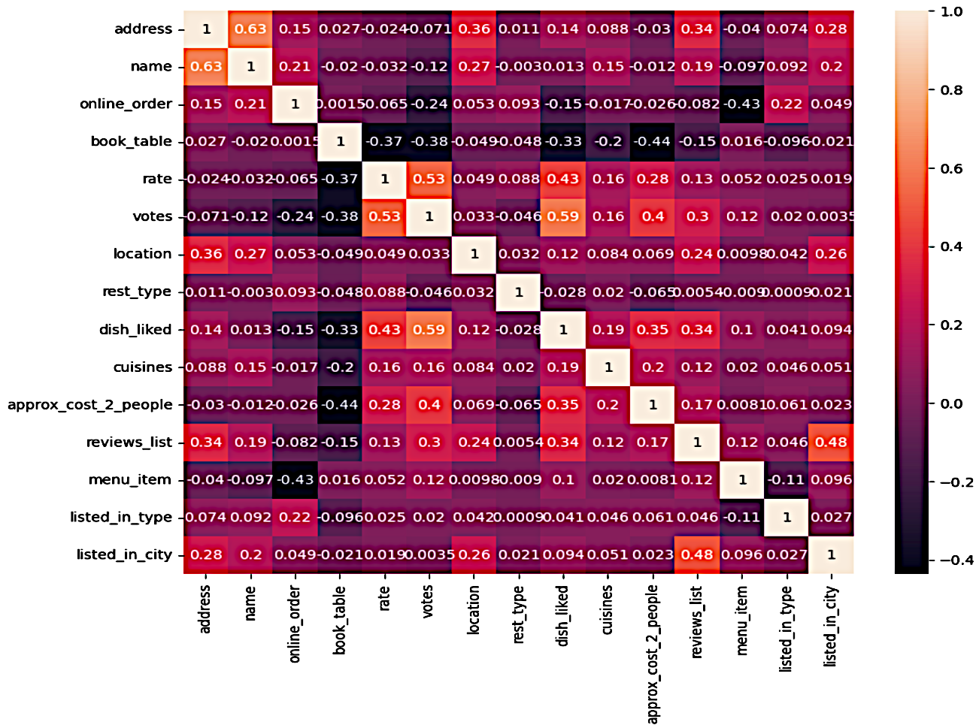
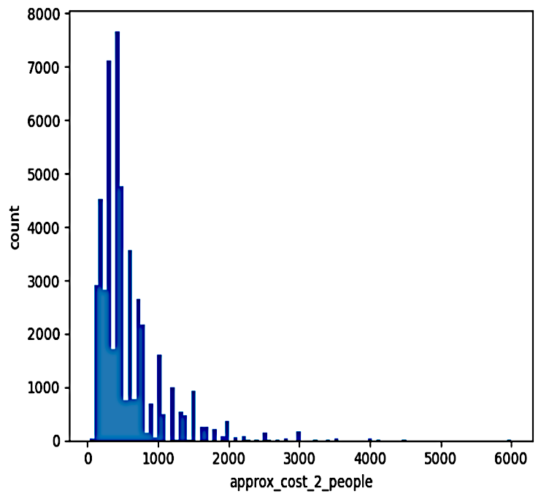
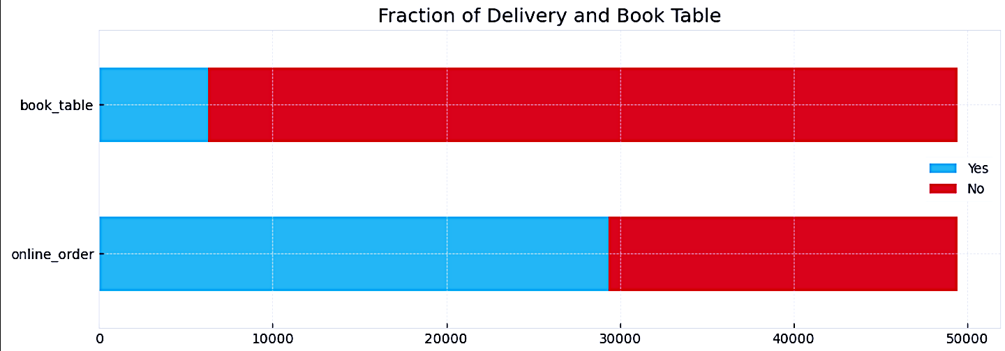
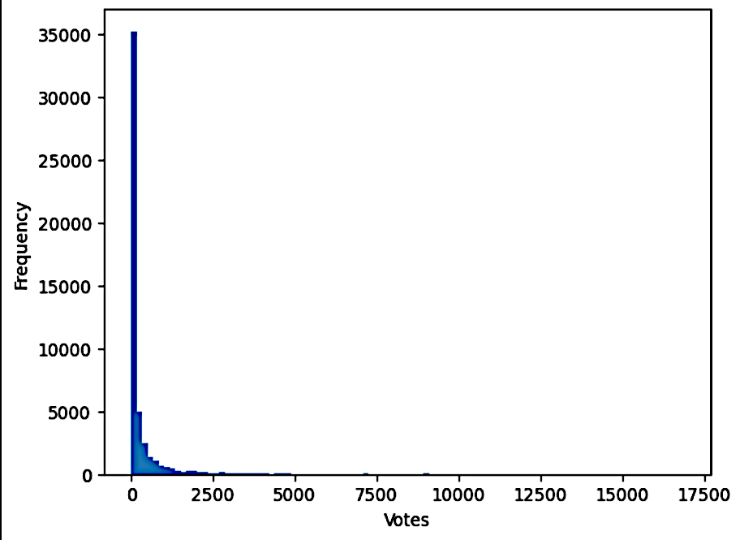
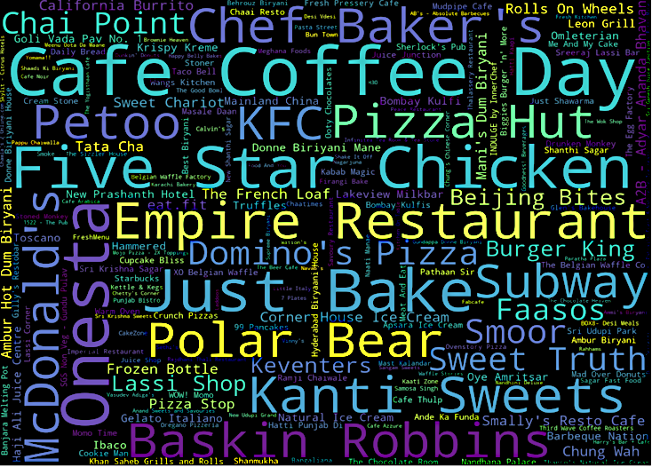

Slide 8
Technical Implementation
We implement naïve bayes multinomial by map reduce, in the map stage we make a map or dictionary
that take the class and its label then add 1 ti this pair with different Labels then in the reduce function we collect
All ones for all classes
So now we have a frequency table for each class then in predict stage we also use map function to calculate
the posteriors and take the maximum one, all of that we put it in NB class that we initiate a object as a naïve bayes
model before start our journey.

Slide 9
Results
The restaurants that have rate more than 3.9 is higher than the restaurants that have rate Less than 3.9
The accuracy of our model is 84%

